Slide 1

Review Session!
We have a test next week, Oct 10th 2023
Here in the lecture hall!

Slide 2

The Test Details.
There will be a piece of paper being handed out when the test starts(so bring a pen or pencil)
You will need to fill this out with your full name & Student ID.
There is problem to solve on this paper that is mandatory that you complete and hand in. (closed book)
If the paper is not handed back to me. You will receive a ZERO on the test.
After you have handed in the paper, the rest of the test will be open book.
Test consists of multiple choice, fill in the blanks & True/False.
20 Questions, 50 minutes.
22% of final grade!

Slide 3

Office 365 Profile Photo
By now you should all have a photo of yourself inside the SLC’s Microsoft 365’s profile.
If you do not this is mandatory & your face must be easily identifiable.
This helps us with the large class size to put a name to the face.

Slide 4

Definition of a Database.
In computing, a database is an organized collection of data stored and accessed electronically through the use of a database management system. Small databases can be stored on a file system, while large databases are hosted on computer clusters or cloud storage

Slide 5

Characteristics Of Databases
The reason databases are used is to keep track of things.
Databases store more complicated information than simple lists like a spreadsheet.

Slide 6
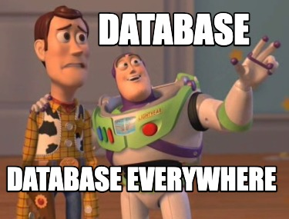
Relational Database Tables
Relational model is a methodology used as a solution for database design.
A relational database contains a collection of separate tables.
A table holds data about only one theme.
Each column, also known as fields, in a table stores a characteristic common to all rows in a table. An example is StudentNumber.
A row in a table, also known as a record, has data about an occurrence. An example would be all the information on one student.

Slide 7
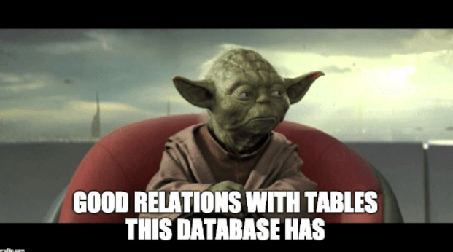
Table Relationships
There are 3 types of table relationships in Microsoft Access
• One-to-Many
• Many-to-Many
• One-to-One

Slide 8

Primary Key
A primary key is a unique identifier for a record in a table. It ensures that each record within the table is distinct and can be uniquely identified.
Primary keys must contain unique values, meaning that no two records in the table can have the same primary key value.
Primary keys can consist of one or more columns (composite primary key), but the combination of these columns must still be unique.
Primary keys are used to enforce data integrity and maintain the referential integrity of the database.
In Microsoft Access, you can set a primary key by selecting one or more columns in a table and marking them as the primary key through the table design view.

Slide 9

Foreign Key
A foreign key is a field or a set of fields in one table that refers to the primary key of another table. It establishes a relationship between two tables by defining a link between them.
Foreign keys are used to maintain referential integrity, ensuring that data relationships between tables are consistent and valid. They help enforce rules that dictate how data in one table relates to data in another.
Foreign keys do not have to contain unique values in the table where they exist; they are essentially references to the primary key values in another table.
Foreign keys are typically used to create relationships such as one-to-many or many-to-one between tables. For example, in a database for a library, a "Book" table might have a foreign key that references the "Author" table's primary key, linking each book to its respective author.

Slide 10
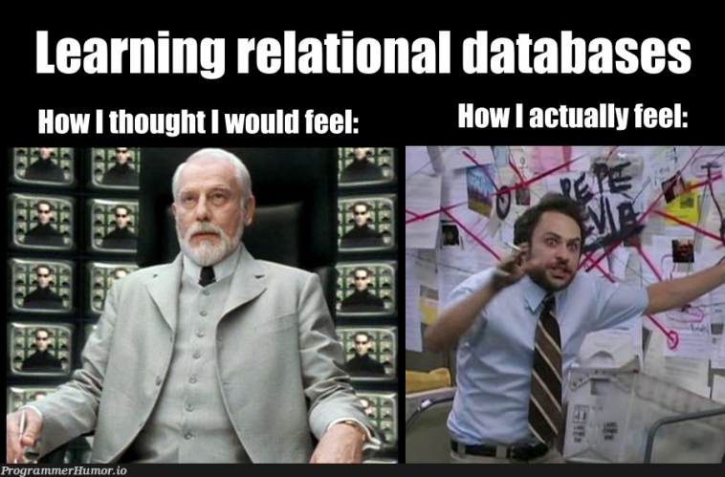
Forms
Database forms are user interface components within a database system.
They simplify data interaction and input by acting as an intermediary between users and database tables or queries.
Forms provide a user-friendly presentation of data, often with labels, text boxes, buttons, and navigation controls.
They enhance data entry, validation, and modification processes, promoting data accuracy and efficiency.
Forms can be customized to suit specific application needs, including displaying data from multiple related tables.
Automation features within forms allow for tasks like data processing and validation rule enforcement.
Forms seamlessly integrate with other database components, contributing to the creation of intuitive and efficient database applications.

Slide 11

Referential Integrity
Referential integrity means that the foreign key in any
referencing table must always refer to a valid row in the
referenced table.
• Referential integrity ensures that the relationship between two
tables remains synchronized
• While creating Relationships, you could also enable Cascade
Update, and Cascade Delete

